Slide 1
LAB- 5 Study the concept of VLAN
Computer Network(CN)
DU #2104CS301
Prof. Dolly A. Bharvada
Computer Science & Engineering Department
Dolly.bharvada@darshan.ac.in

Slide 2
✓
Outline
What is VLAN?
Need of VLAN
Advantages of VLANs
Access and trunk interface
Configuration of VLAN
Step to configure VLANs

Slide 3
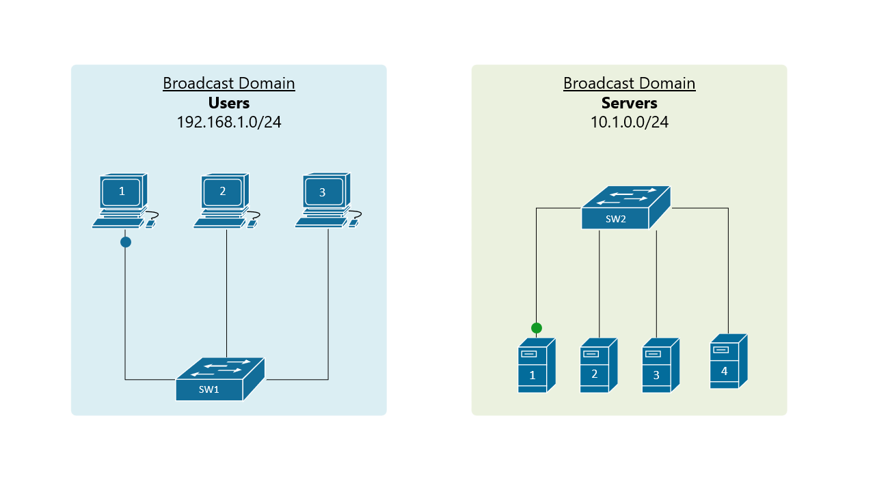
Broadcast in LANs
A broadcast domain is a set of devices that can receive broadcast messages from each other.
Broadcast messages are packets that are sent to all devices on the same network, such as ARP requests or DHCP offers.
Broadcast messages are useful for discovering and configuring network devices, but they can also consume bandwidth and cause network congestion if there are too many devices or too much traffic on the same network.
Here 2 different networks LANs switch forwards traffic.

Slide 4
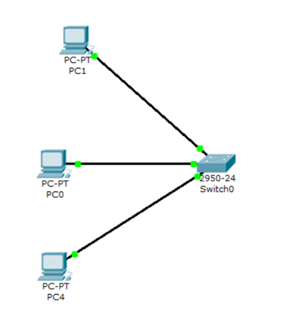
Broadcast in LANs
Two different LANs
LAN 1
LAN 2

Slide 5
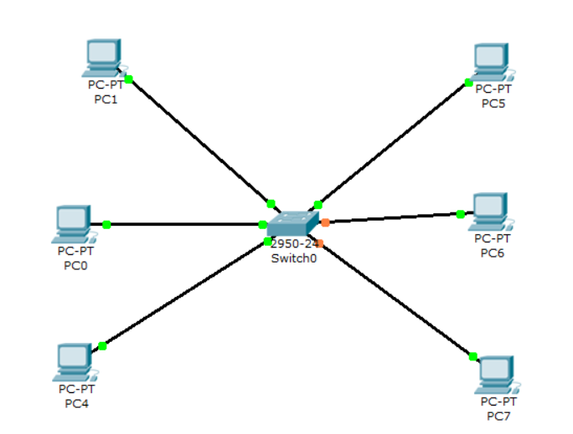
Broadcast in LANs
Design a two LANs which has one switch and three PCs. LAN 1 PCs can’t communicate with LAN 2
If you connect the system as shown in figure then LAN 1 PC can communicate with other
So how to separate them logically.
What is solution?
LAN 2
LAN1
Solution of this is VLAN

Slide 6


VLANs are logical grouping of devices
in the same broadcast domain.
logical grouping
same broadcast domain
VLAN – Virtual LAN

Slide 7







VLANs
192.168.10.3
192.168.10.5
VLAN 1
VLAN 3
192.168.10.2
192.168.10.7
VLAN 2
192.168.10.4
192.168.10.6

Slide 8
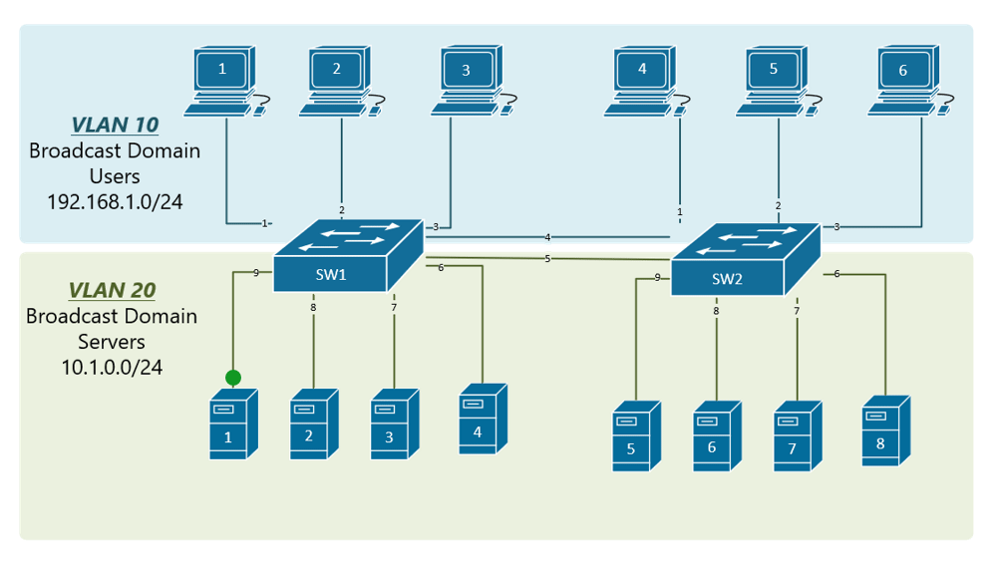
VLAN
Virtual LANs or VLANs are usually configured on switches by placing some devices into one broadcast domain and some devices into some other broadcast domain.
VLANs keep traffic from different networks separated when traversing shared links and devices within a topology.
Each VLANs acts as a subgroup of the switch ports in an Ethernet LAN.
VLAN 2

Slide 9
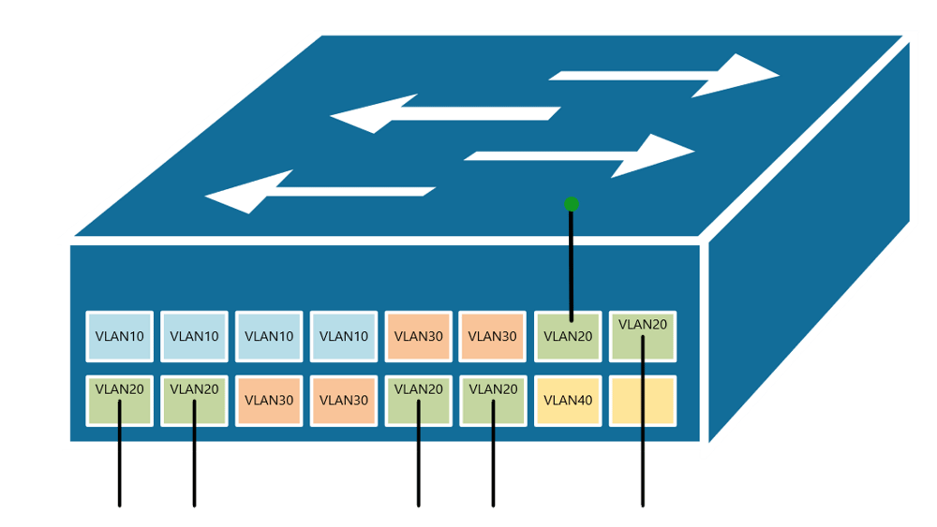
VLAN Example
VLANs per port view

Slide 10
Advantages of VLAN
It improves the security by reducing the number of end-stations that receive copies of BUM (Broadcast, Unicast, and Multicast) traffic.
It creates smaller fault domains by isolating different groups of devices in separate broadcast domain.
It reduces the CPU overhead on each device in the LAN by limiting the number of broadcast frames received.
It improves network performance and speed of failure recovering.

Slide 11
Access and Trunk Interfaces
Ethernet interfaces can be configured in two ways:
Access ports
Trunk ports.

Slide 12
An access port can have only one VLAN configured on the interface; it can carry traffic for only one VLAN.

Slide 13

An access port can have only one VLAN configured on the interface; it can carry traffic for only one VLAN.
Access Port
Access Port
Access Port
Access Port
Access Port
Access Port

Slide 14
VLANs on multiple switches
VLANs spanned on multiple switches without Trunking

Slide 15
A trunk port can have two or more VLANs configured on the interface; it can carry traffic for several VLANs simultaneously.

Slide 16
A trunk port can have two or more VLANs configured on the interface; it can carry traffic for several VLANs simultaneously.
Access Port
Access Port
Trunk Port
Trunk Port
Access Port
Access Port
Access Port
Access Port

Slide 17
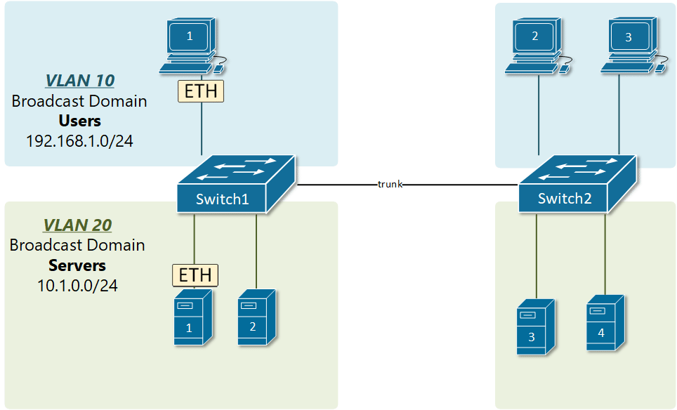
VLAN Tagging
VLAN trunking allows switches to forwards frames from different VLANs over a single link called trunk.
This is done by adding an additional header information called tag to the Ethernet frame.
The process of adding this small header is called VLAN tagging.
VLAN Data Frame
6 bytes
6 bytes
4 bytes
2 bytes
46 - 1500 bytes
4 bytes
Destination Address
Source
Address
VLAN
Tag
Length/
Type
Data
FCS
TPID
PRI
CFI
VID
2 bytes
3 bits
1 bits
12 bits
TPID -
Tag Protocol Identifier, indicating the frame type, i.e., IEEE 802.1Q frame.
PRI -
Priority, value from 0 to 7
CFI -
0 -> MAC encapsulated, 1 -> non-encapsulated
VID -
VLAN ID, ranges value from 1 to 4094

Slide 18
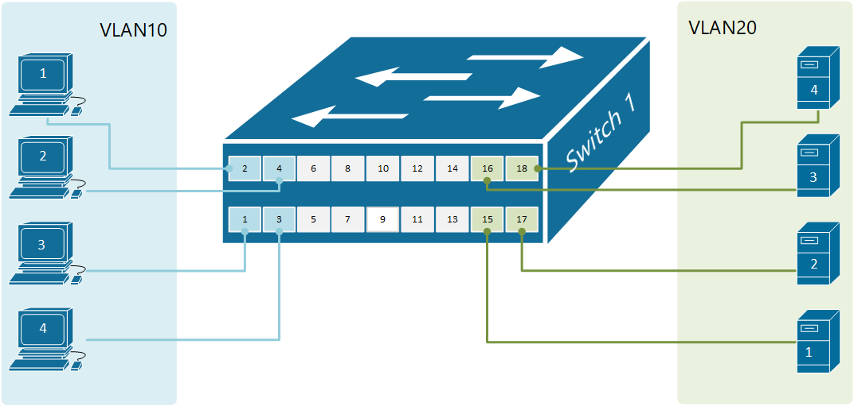
Configure VLAN
Example of a switch with two VLANs

Slide 19
Steps to create VLANs
In the CLI tab of the switch type conf t and press enter
Type vlan 10 on the prompt and press enter
Type name A BLOCK on the prompt and press enter
Enter exit on the prompt and press enter
Type vlan 20 on the prompt and press enter
Type name C BLOCK on the prompt and press enter
Enter end on the prompt and press enter
Type show vlan brief and press enter
Type conf t and press enter
Type interface range fa0/1 – 4
Type switchport access vlan 10
Type switchport mode access
Type exit

Slide 20
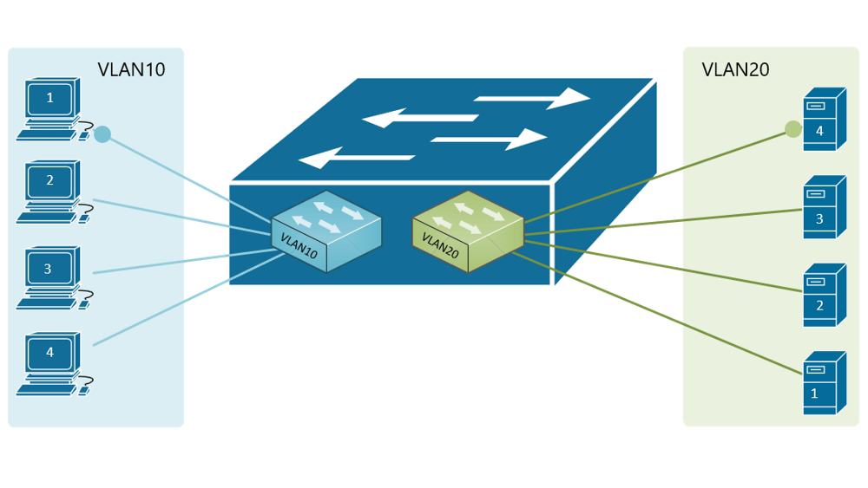
Steps to create VLANs
Type exit and press enter
Type interface range fa0/15-18
Type switchport access vlan 20
Type switchport mode access
Type end and press enter
Type show vlan brief and press enter

Slide 21
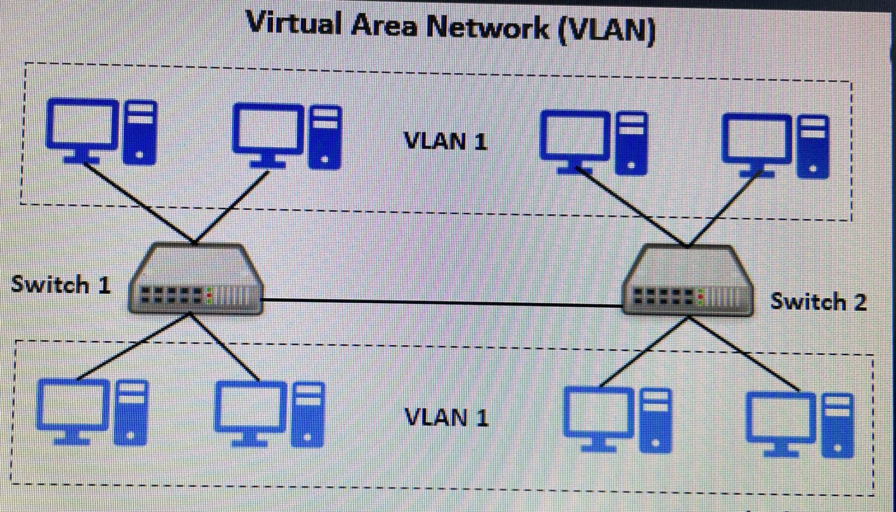
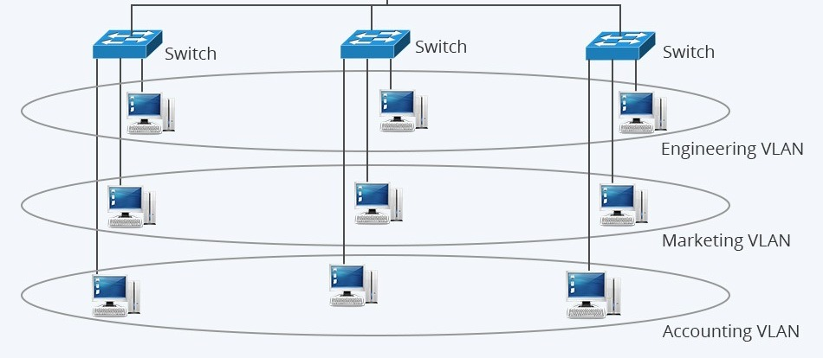
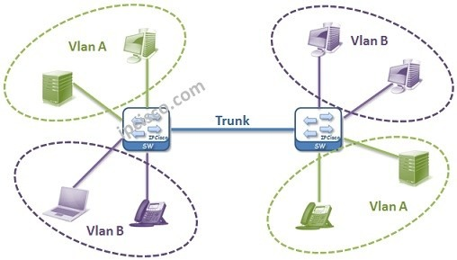
Sample VLANs
1)
3)
2)

Slide 22
Thank you

